Slide 1
An Introduction to Neural Networks
Dubna University
Chris Kullenberg
Oct. 16 2019

Slide 2
What is a Neural Network (NN)?
Neural Networks are effectively function approximators
They are loosely modeled on neural activity in the brain (neurons fire or remain silent based on sensory input)
NN^{s} have many, though not unlimited, applications

Slide 3
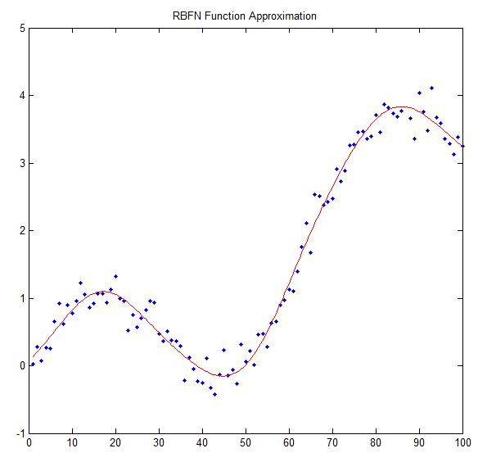
Function approximator?
A NN with ∞ neurons can reproduce any function
In practice this means we can approximate any function
As we increase the number of neurons we get closer to the actual function
How is this useful?

Slide 4
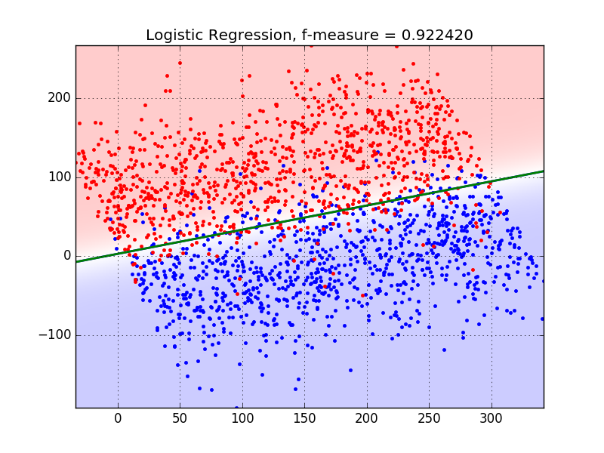
Example: Population Separation

Slide 5
Typical Applications
Physics analysis (classify events, reconstruction)
Medical diagnosis
Finance (market prediction, loan classification)
Image processing (facial recognition, self-driving)
Nearly any classification problem

Slide 6
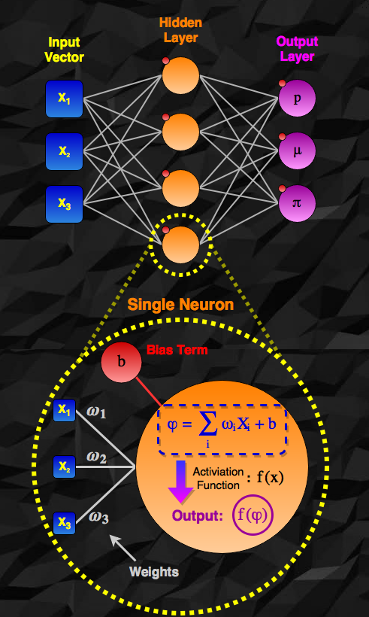
Basic Structure of a NN
Network is composed of neurons fully connected to network inputs and each other
The output of a neuron is a weighted combination of its inputs, with an added constant (bias term) (and an applied activation function)
Weights and biases are the parameters of the network
We want find the parameters that produce the desired output

Slide 7
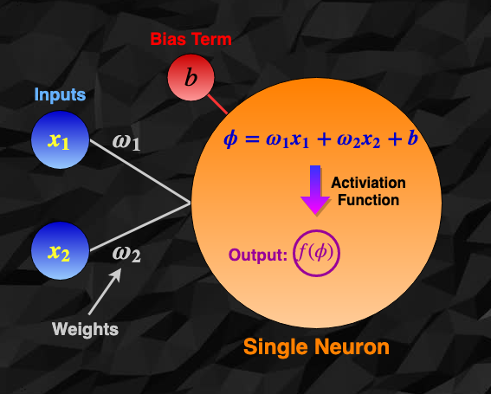
A Single Neuron

Slide 8
Activation Functions
Activation functions provide non-linearity to the network (necessary for generalization to any function)
Multiple layers of neurons without activation functions are equivalent to a single layer
(just linear combination of the inputs)
In the same way, a linear activation function will provide no additional complexity.
So activation functions must be non-linear!

Slide 9
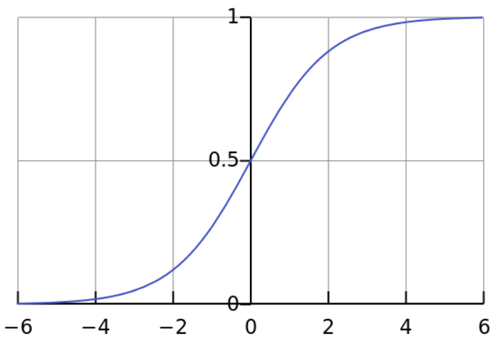
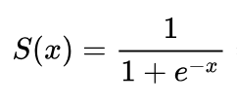
Sigmoid: the classic activation function
Output range: (0,1)
Like On/Off state of a real neuron
Continuous!
Between x range (-4,4) we have a smooth transition from 0 (inactive) to 1 (activated). This is important!

Slide 10
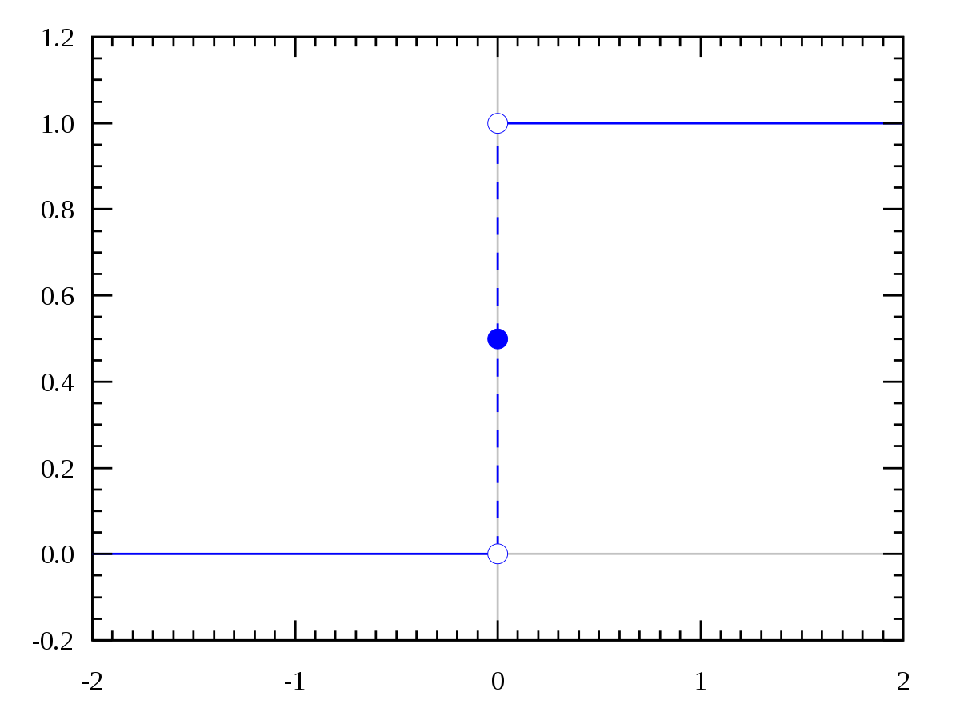
Why do we want a smooth activation function?
Small changes in weights move us along this curve
At some point a small change will cause a sudden change in the activation of the neuron
This will cause chaotic behavior in the network
Bad!
We need a continuous activation function so that the network changes smoothly when modifying the parameters!

Slide 11
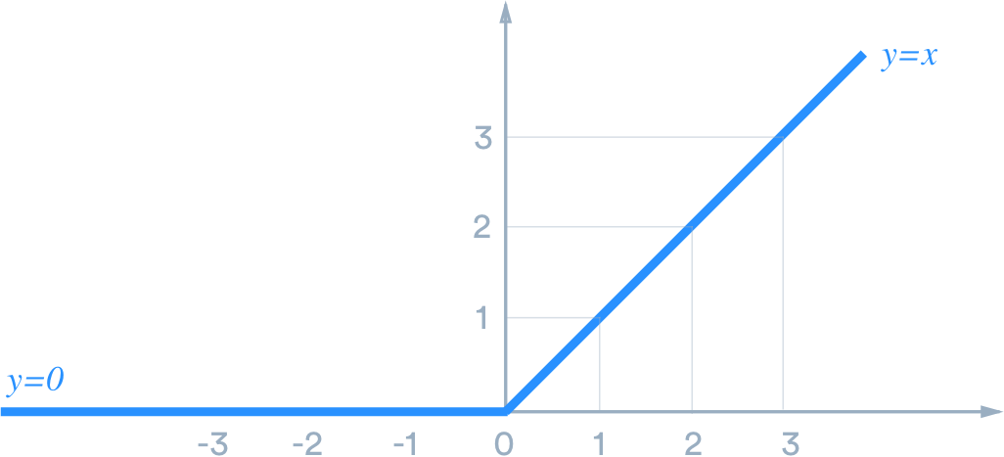
ReLu: The new activation function
ReLu is non-linear, because all negative inputs are
changed to zero
Used to avoid small contributions from neurons in early layers in deep networks

Slide 12
Why a bias term in the sum?
Let’s use the Sigmoid activation function
Let’s also assume that the input to the function is always very large (without a bias term):
(ω₁ x₁ + ω₂ x₂ ) > 1000
The neuron output will always be 1, because the inputs to the activation function are always much larger than 4!
Always returning 1 (independent of input) is not very useful
We need to shift the inputs down by ~1000 to put them in a range where the sigmoid function can discriminate
This is done with the bias term, which is learned for each neuron

Slide 13
Training the network
First initialize all network parameters
(traditionally this is done randomly)
Then pass labeled data (with the correct answers) through the network
Check how correct the network solution is (Cost function)
Modify parameters to make the network solution a bit more correct (Backpropagation)
Continue running data through the network and modifying parameters until desired accuracy is achieved
(or for a set number of repetitions)

Slide 14
Training Data
We need a set of labeled data to train the network (supervised learning). This will be N entries, each with:
A list of input variables: x₁, x₂, x₃ ….
The “solution” for each entry (correct category, for example)
We split this data into a training and testing set (generally 2/3 and 1/3 of the full set, respectively)
The training set is used to train the network, or tune its parameters
The testing set is used to test the network on data it has not seen during learning

Slide 15
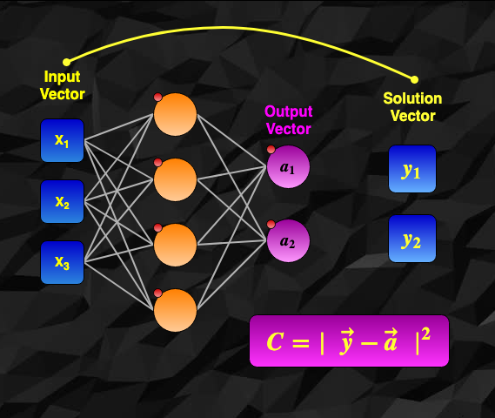
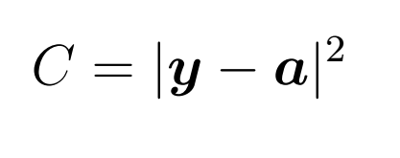
Cost/Loss Function
The Cost function tells us how correct the network output is. It is any function such that the minimum value occurs at the correct solution.
We want this to be a minimum because we will use its gradient to modify parameters
A typical cost function:
Where a is the network
output and y is the correct
solution from the data.

Slide 16
Modify parameters
To modify the network parameters we use Backpropagation, or Gradient Descent
Effectively we calculate the partial derivatives of the cost function with respect to all of the parameters. This gives us the gradient.
We then move a small amount in the direction opposite of the gradient (want lower cost function) by a small change in the parameters
If we make many steps towards a smaller cost function we should eventually find a minimum (and so a small difference between the network output and the true values)

Slide 17
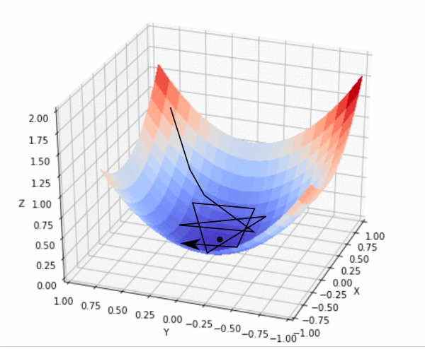
Gradient Descent
We may find a local minimum, rather than global, which is fine.
If we are not careful with the step size we may bounce around the minimum.

Slide 18
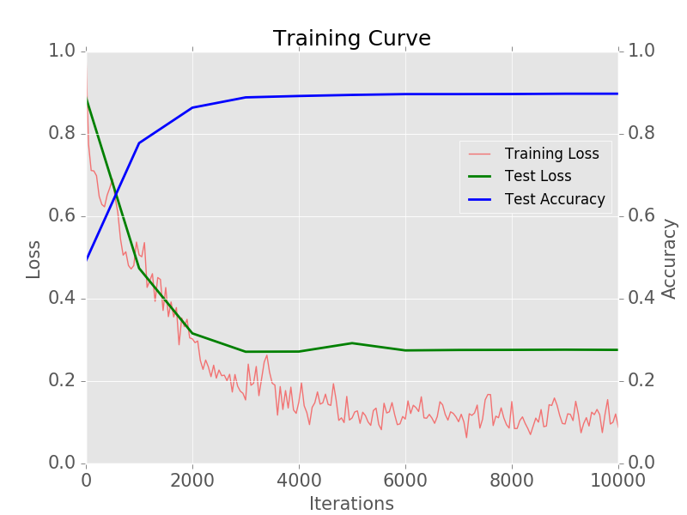
Accuracy/Training Plots
Here we have a typical example of training curves for a network.
Blue shows the accuracy of the network predictions (test data set)
Green and Red show the value of the Cost/Loss values for the
testing and training data sets, respectively.
Here the accuracy reaches ~90%
This level of accuracy is reached rather early in the training

Slide 19
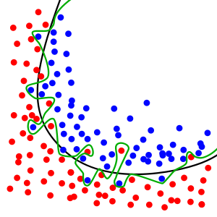
Overtraining
It is possible for a network to Overtrain, or for it to learn specific features of its training data too well
In this case the network will not be as general, and will not perform well on data it has not seen before
This is much like overfitting, which you can see in this plot. The black curve would be a good separating function, while the green curve focuses too much on this particular data set.

Slide 20
Test/Training loss when overtraining
We can see overtraining occur in our example plot. After
2000 iterations the loss from the training data continues to drop, while the test loss does not improve. These curves should overlap.
It is probably best to stop training this network near 2000 iterations (maybe 3000).

Slide 21
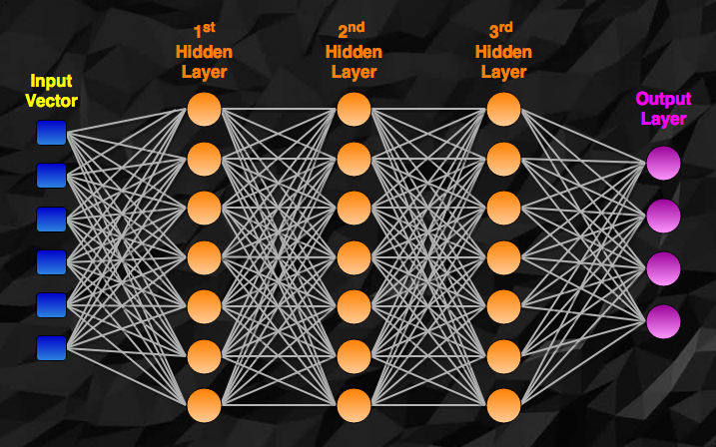
Deep Neural Networks

Slide 22
Why are Deep NNs possible now?
Traditionally Deep networks (large NNs) were not feasible. They are now possible due to improved hardware, as well as the following:
The ReLu activation function allows neurons in early layers to have an effect on the Cost function’s gradient
It was found that most local minima are as good as the global, so it is not necessary to search too hard for it
Stochastic Gradient Descent (checking the gradient after small batches, rather than after the full training set)
New methods of parameter initialization (instead of random)

Slide 23
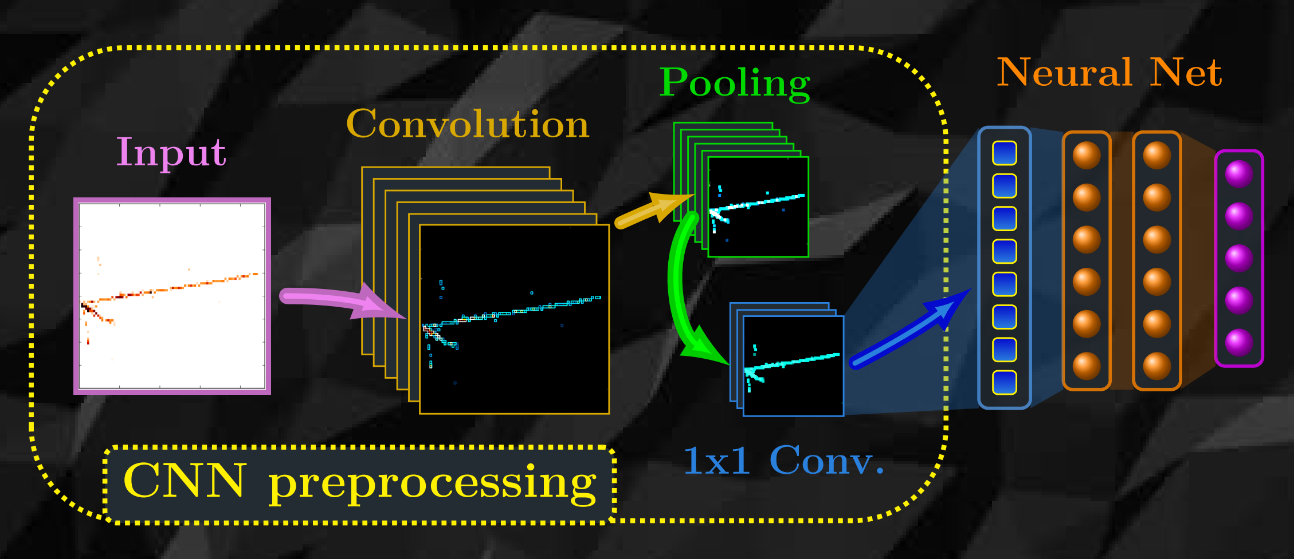
Convolutional Neural Network (CNN)
Effectively a set of image preprocessing steps which feed into a standard Neural Network

Slide 24
Why is preprocessing necessary?
Using each pixel of a large image as input will create a massive Neural Network
A simple NN may not be able to find the desired object in a different position of an image (spatial invariance)
Convolution can also find “features” that a pure NN may not ever learn

Slide 25
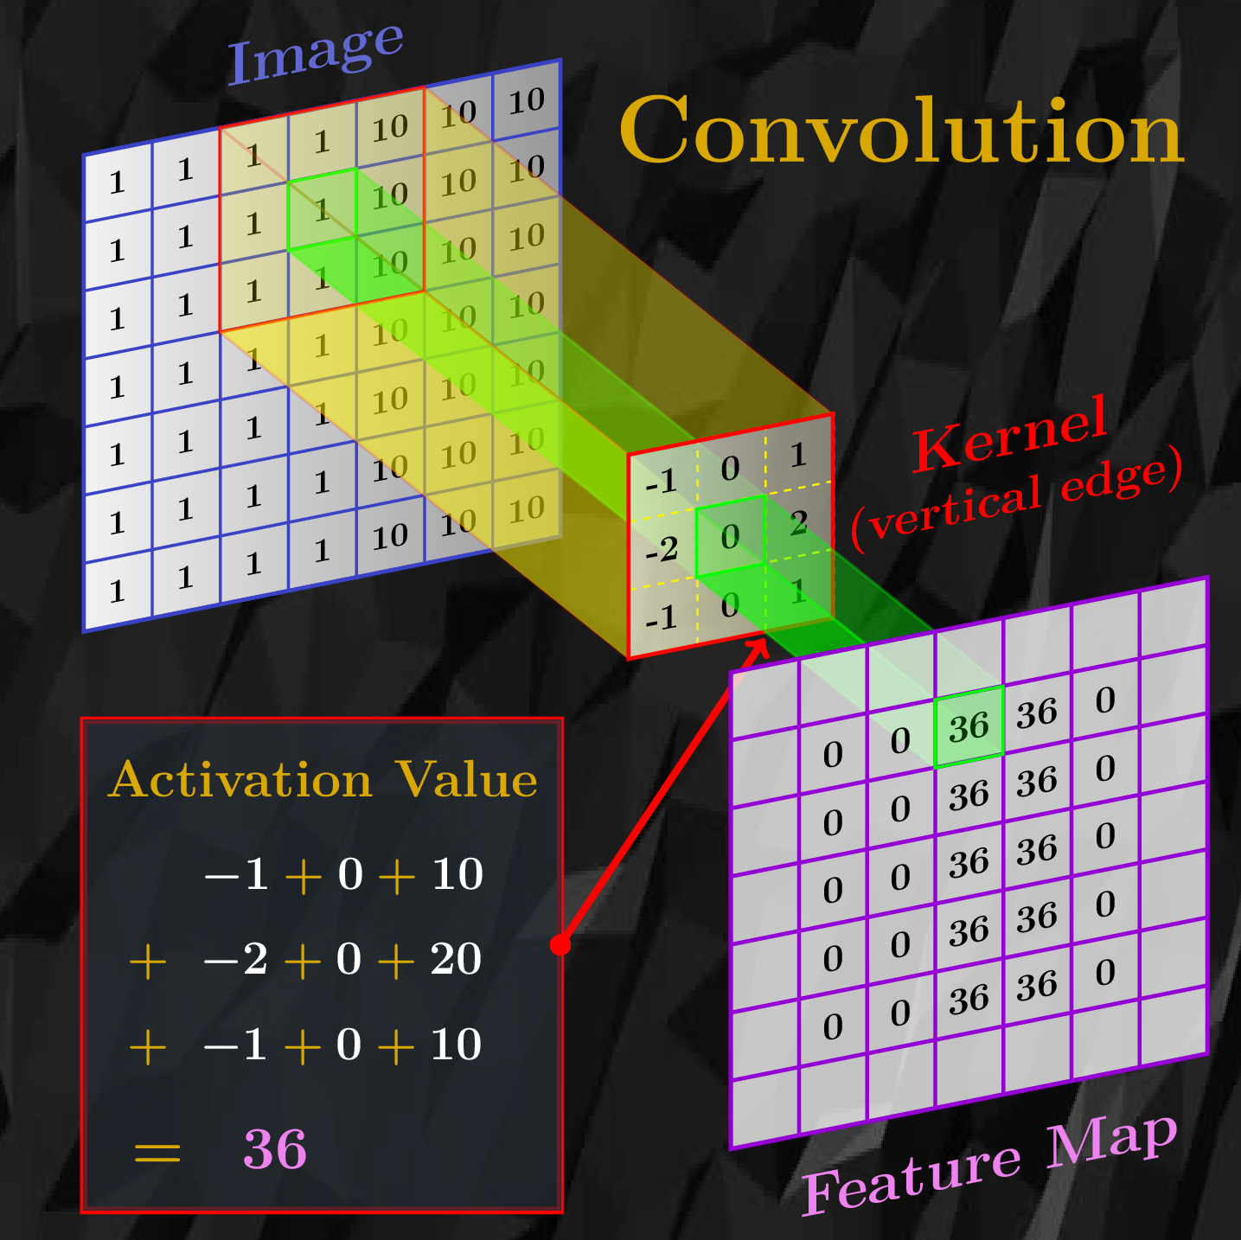
Convolution (pattern searching)
The Kernel / Filter is a simple matrix
The kernel is moved along the input, and the sum of the products of the kernel values and the image values under the kernel are used as output (simply a weighted average)
The resulting output is the Activation / Feature Map
The Stride is simply the number of spaces the kernel moves with each step
The output layer is sometimes padded with zeros to have a size consistent with the input layer (Padding)

Slide 26
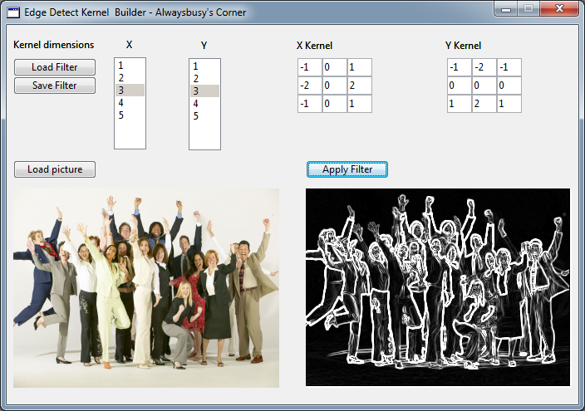
Convolution example: Edge finding
Kernels are generally learned by the network!

Slide 27
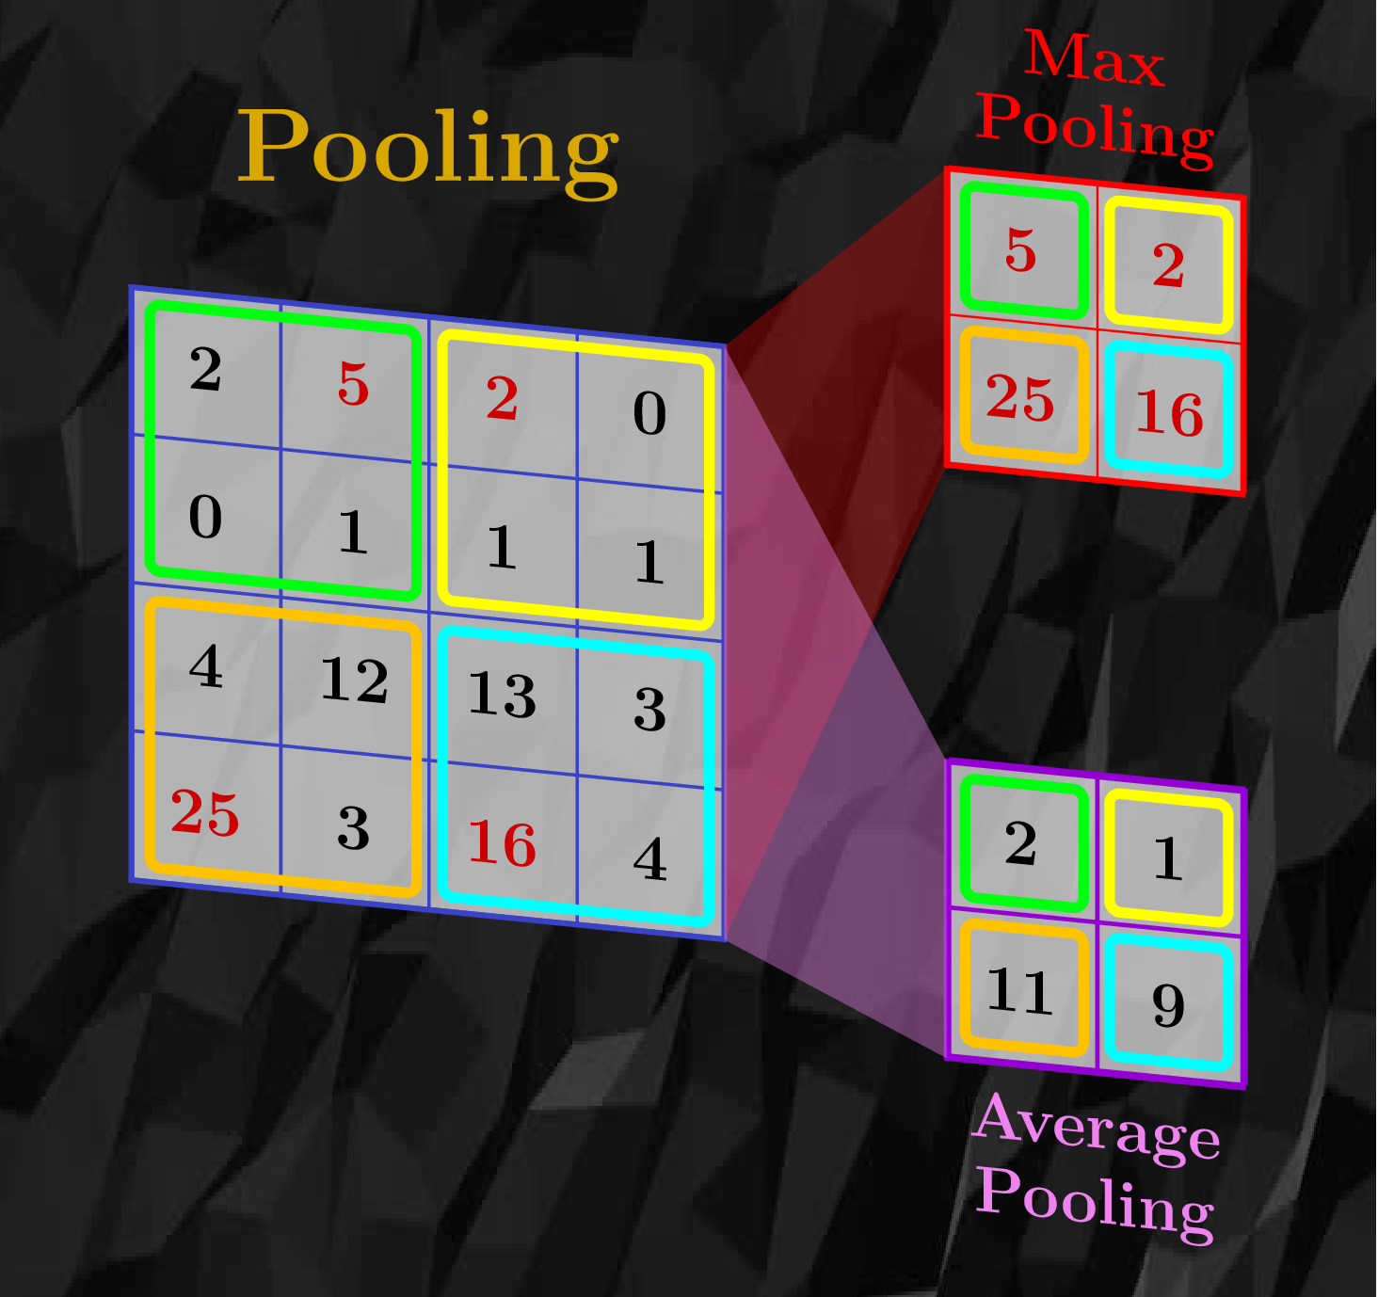
Pooling (information reduction)
Pooling is used to reduce the information flowing to the network, while keeping important activations
In this way we retain the general locations of features (kernel activations), without keeping less interesting information
Max Pooling: Keep only the largest activation in an area of the feature map
Average Pooling: Average all activation values within the area

Slide 29
1x1 Convolution
(information reduction and pattern interweaving)
This layer is used to reduce the parameter space and interweave patterns from feature maps
It is surprisingly powerful, and further helps to detect features while reducing data flow
Basically, feature maps are added together with weights, which become network parameters.
So if we have 200 kernels, and so 200 feature maps, we can add them together with weights to make as many/few outputs as we like.
One can imagine adding a vertical edge feature map to a horizontal one, to get a general edge detection, so 2 maps become 1 more powerful map

Slide 30
Dropout Layer
Used only during training!
Applied to fully connected layers
(the neural network at the end)
Nodes are randomly removed from the training process by setting their weights to zero
This promotes redundancy in the network, and guards against overtraining

Slide 31
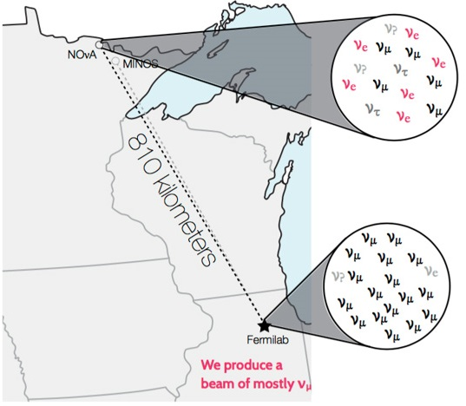
Example CNN use in physics? NOνA!
NuMI Off-axis ν_{e} Appearance
Measure neutrino oscillation parameters!
(among other interesting neutrino topics)
Neutrino oscillations cause different neutrino flavors to appear during interaction than when created during production
Understanding these oscillations helps us understand fundamental properties of the neutrino
The beam composition is measured at the Near Detector (mostly muon neutrinos)
The number of electron/muon neutrinos appearing at the Far Detector provides the oscillation measurement

Slide 32
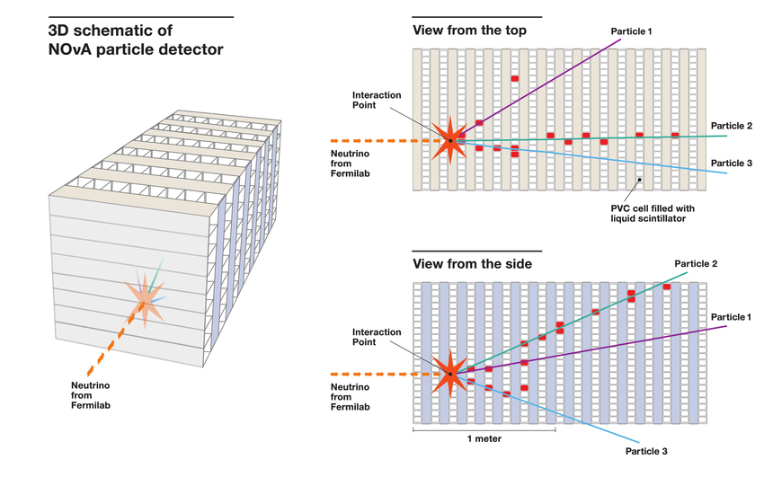
NOvA Data

Slide 33
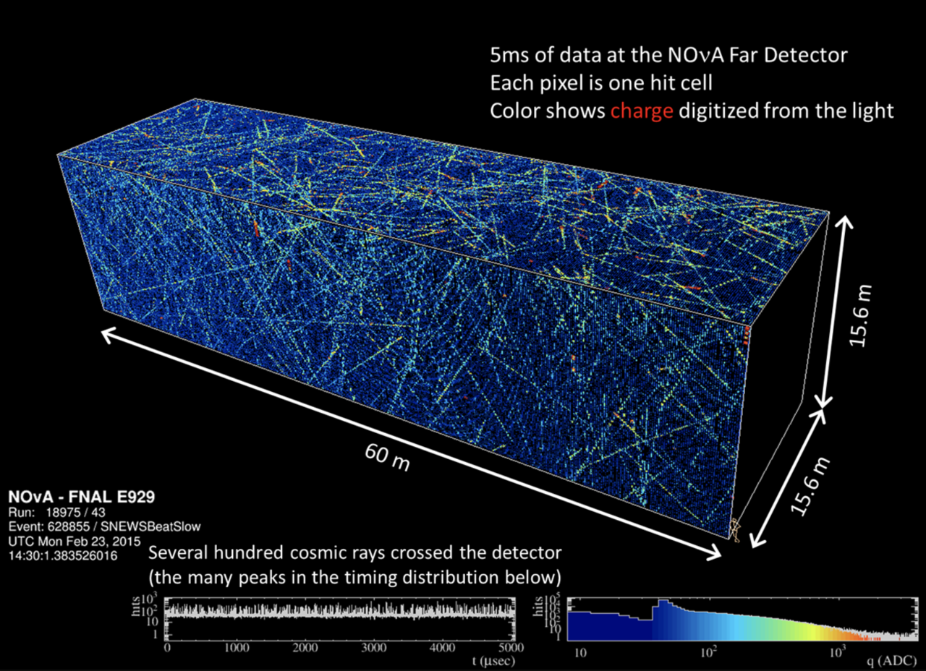

Slide 34
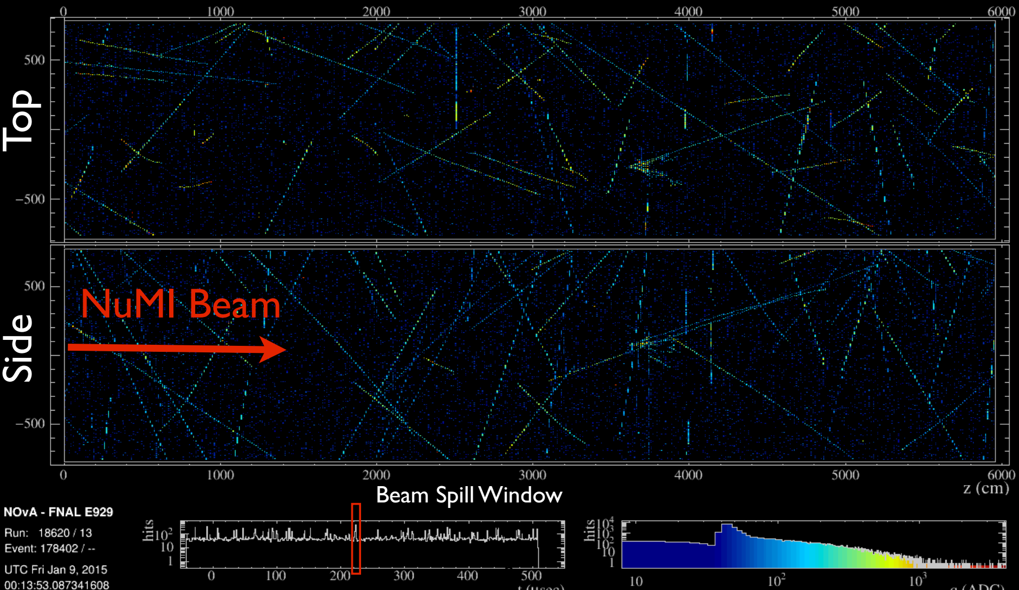
NOvA Data
550 μs window in the Far Detector

Slide 35
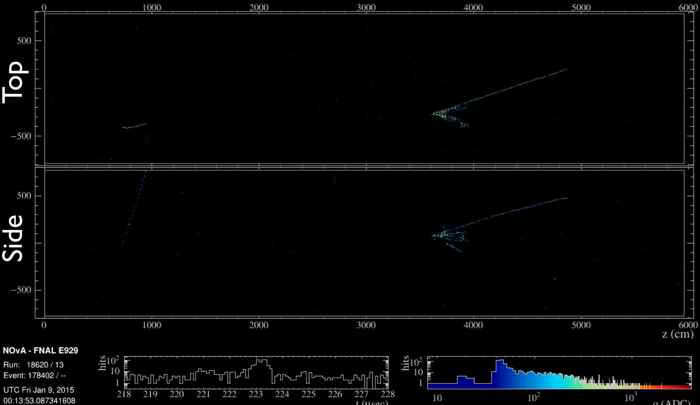
NOvA Data
10 μs window during active beam

Slide 36
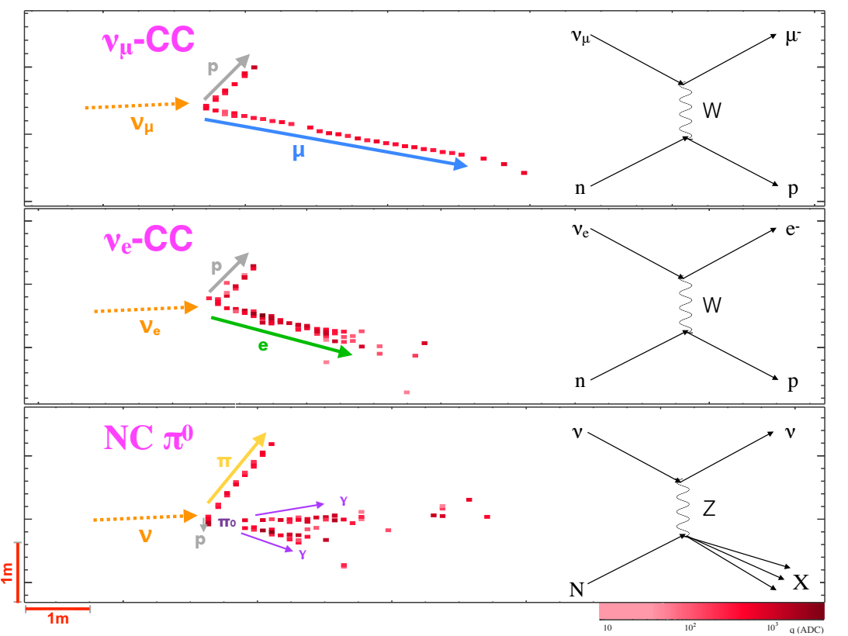
How to Distinguish Neutrino Types?
ν_{μ}
ν_{e}
NC

Slide 37
Network Inspiration
Inception modules are groups of Convolution/Pooling layers that include 1x1 Conv. to reduce the parameters in the network, allowing for deeper networks.

Slide 38
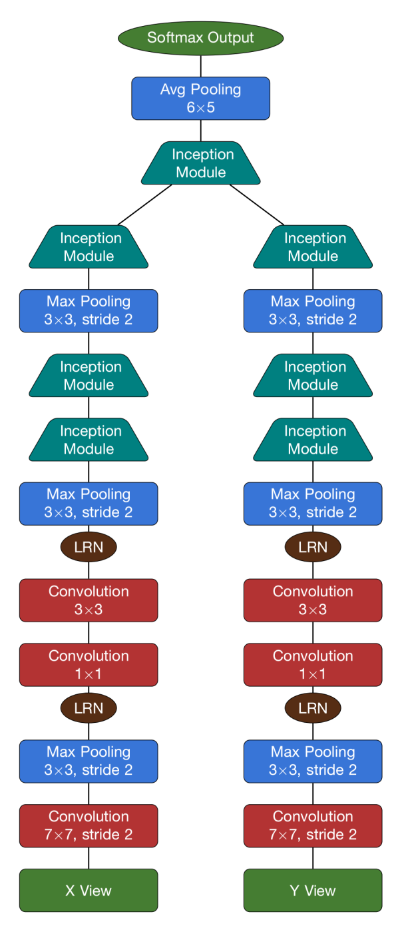
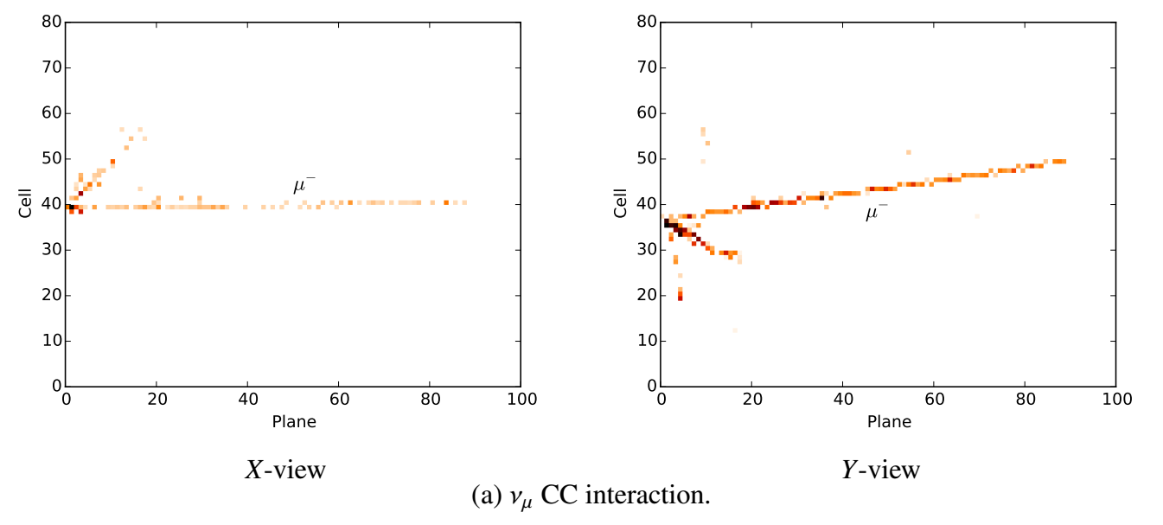
NOvA’s Event Classification CNN
80x100 matrix of energy deposits are extracted from the detector data. Greatly reduces data flow through network
X and Y-views are sent separately through the two towers of NOvA’s network
The towers are merged, and the network outputs a value for each interaction type, which is Softmax normalized

Slide 39
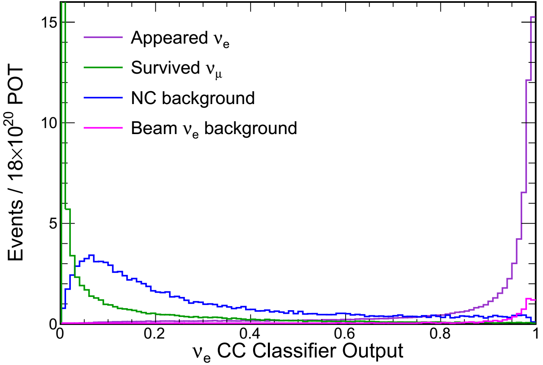
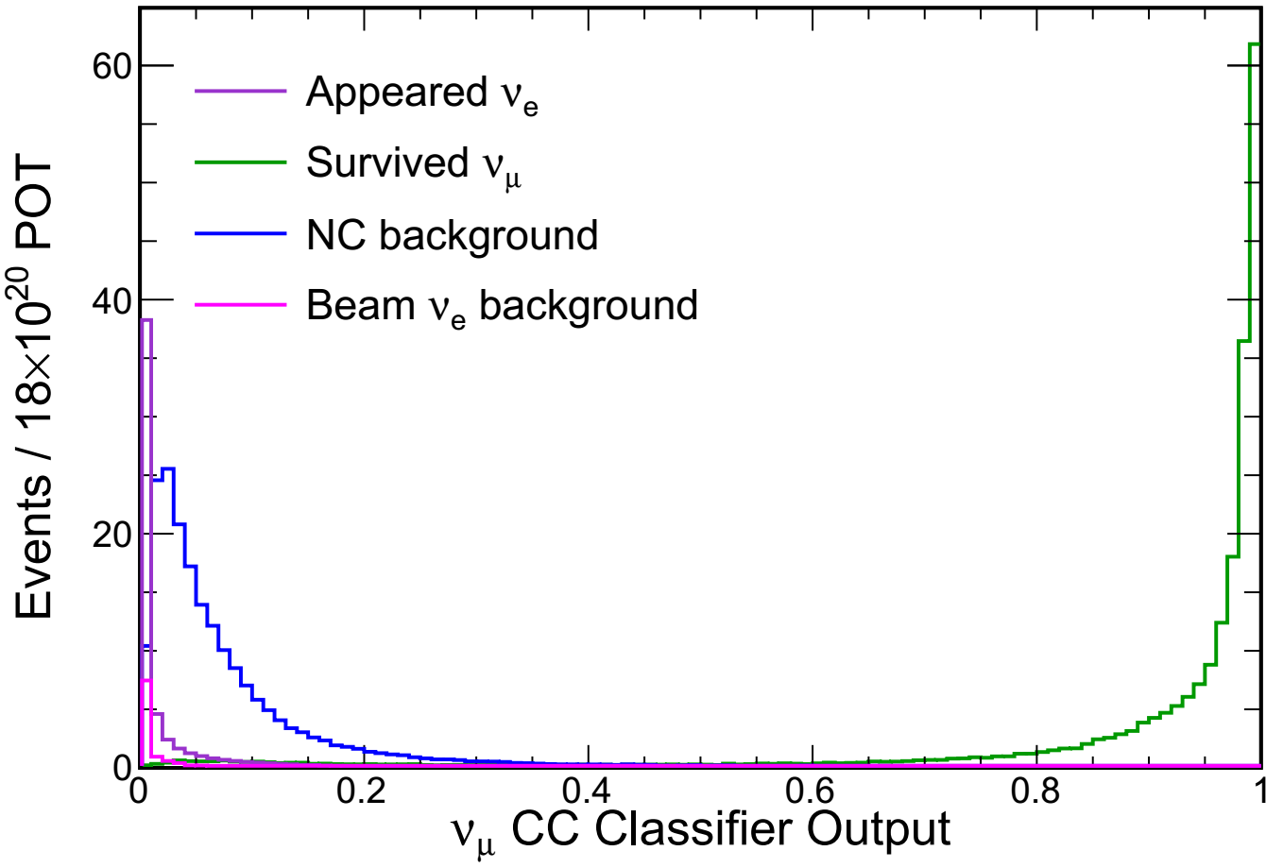
Event Classification Network Results

Slide 40
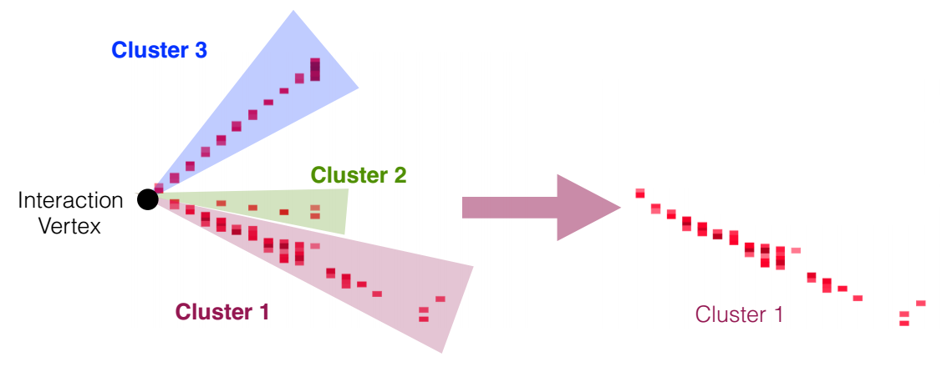
Particle Identification
Particle identification is necessary for in-depth physics analysis.
Neutrino interactions in the detector are simulated
Hits are clustered into tracks
An interaction vertex is determined
Single particle tracks are separated for training

Slide 41
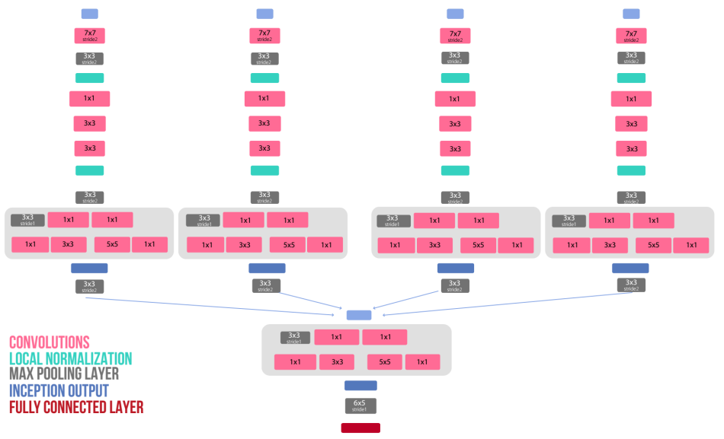
Particle ID Network
Context provides up to an 11% improvement in efficiency and purity!

Slide 42
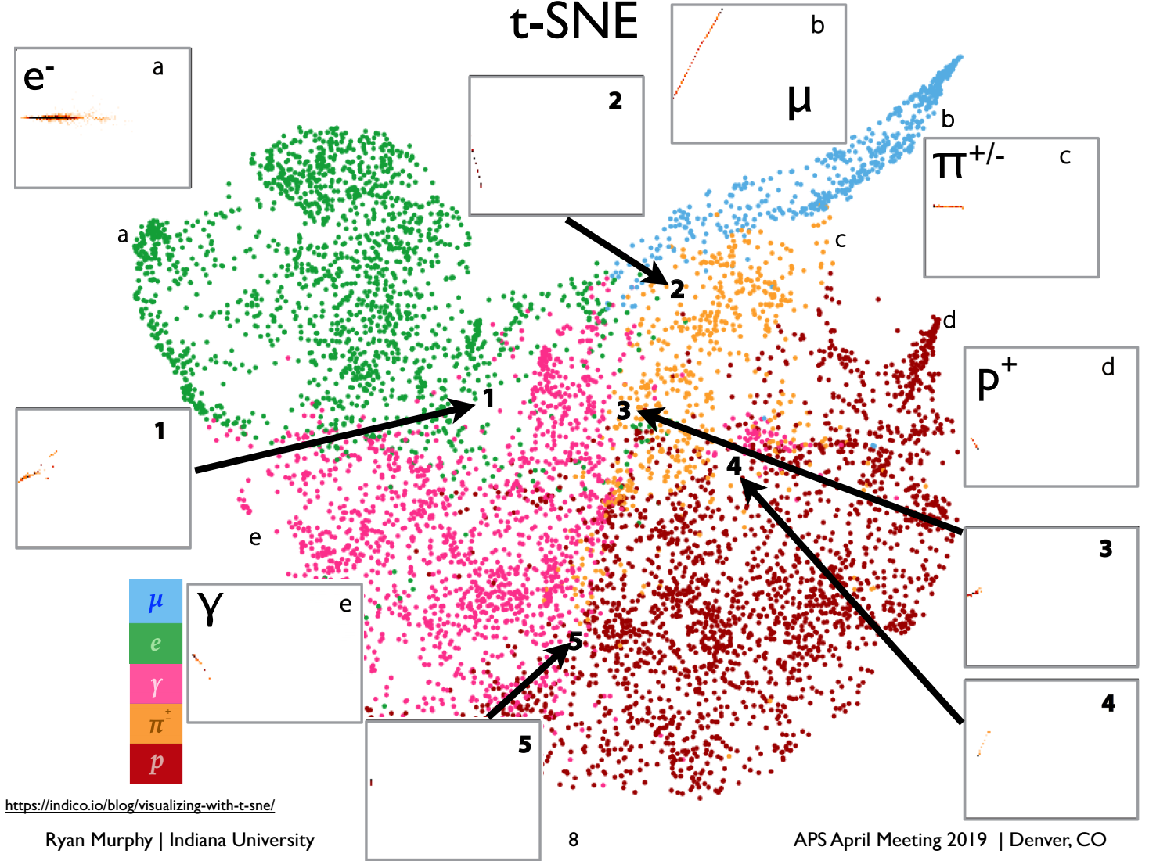

Slide 43
More CNN work in NOvA
Continue to improve event classification network and particle ID network
NOvA has created a CNN to improve ν_{e} and electron energy estimation:
PRD: DOI: 10.1103/PhysRevD.99.012011
Creation of LSTM network to improve ν_{μ} energy estimation
CNN to reduce cosmic ray background
The NOvA test beam detector will provide labeled data from single-particle interactions allowing for data-driven checks of deep learning methods
And more….

Slide 44
Problems with traditional NNs
They require a huge amount of training data (whereas humans can infer from relatively small amount of initial information)
They are a computationally heavy method (requiring large amounts of parallel processing and memory)
They aren’t generally very adaptable, requiring retraining when new situations arise
Constructing a suitable NN is a bit of an art form. There are guidelines, but NNs are not generally understood well enough to make rules based on first principles

Slide 45
Conclusions
We have only looked at one type of NN: the feed-forward NN with supervised learning (labeled data)
Neural Networks are not the only method of Machine Learning (Decision Trees, Regression methods, K-means…)
Innovations happen all the time, as this is a young field!

Slide 46
Questions?

