Slide 1
Archives
Leslie 4th June 2015
Cleaning up my shelves I found a trove of NOMAD documents relevant to our FCAL
Investigation.
NOMAD by numbers: a summary of dimensions and coordinates.
The coil is 23cm thick. It does not give the actual coordinates. However I also found:
2) A neutrino radiography “transparency” a scan of which which I am attaching.
It’s the position of the reconstructed vertex.
It clearly shows in z, all the relevant peaks from the STAR, Achim’s target, the basket
and the coil. It looks as if the coil goes from -25cm to -50 cm.
It also shows the x y vertex distributions for different z slices.
3) A memo on the Extrapolator performance for muons by Cattaneo.
  a )All the checks seem to be with negative muons
  b) The final section is labeled: What is missing and includes
  “Tests should be performed for backward extrapolation through FCAL”.

Slide 2
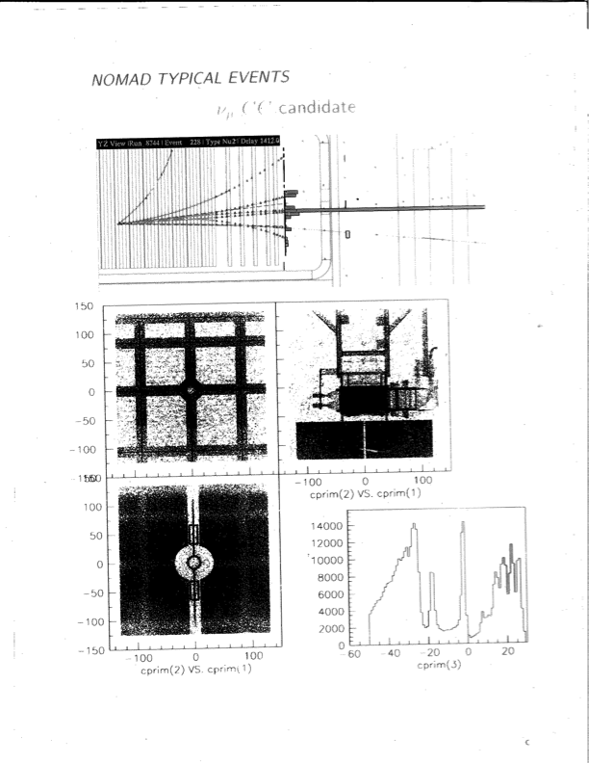
Radiography
cprim(1)=x (cm)
cprim(2)=y(cm)
STAR+
Achim’s Targets
Basket
Coil
cprim(3)=z (cm)

